Slide 1
Genetic Privacy
Junjie Chen
Lab meeting
11/7/2019

Slide 2
Privacy in Daily Life

Slide 3
Google Reveals the 10 Worst Password Ideas
Pet names
A notable date, such as a wedding anniversary
A family member’s birthday
Your child’s name
Another family member’s name
Your birthplace
A favorite holiday
Something related to your favorite sports team
The name of a significant other
The word “Password”
http://techland.time.com/2013/08/08/google-reveals-the-10-worst-password-ideas/?iid=biz-article-mostpop2

Slide 4
Genetic data
genes, gene products, variants, phenotypes

Slide 5
Genetic data
Can’t be changed
Not only yourself, but also your family
Related with your health

Slide 6
Why do you care about genetic privacy?

Slide 7
Genetic Privacy Risks
Identity tracing attacks
e.g. identify a specific individual by their genetic sequence
Attribute disclosure attacks via DNA
e.g. infer propensity for specific diseases or immediate or distant ancestry.
Completion attacks
e.g. complete genetic information from partial data
Erlich, Yaniv, and Arvind Narayanan. "Routes for breaching and protecting genetic privacy." Nature Reviews Genetics 15.6 (2014): 409.

Slide 8
Genomic Data
Privacy Breaches
Privacy Protection
Private/Controlled
Ethics/Regulations
Identity attack
Trait attack
Completion attack
dbGaP
Genotypes and Statistics
Ethics education
EBI
Wheeler 2008
Health Insurance Portability and Accountability Act (HIPAA) Breaches (1996)
Biobanks
Homer 2008
Hospitals
Wang 2009
Shringapyre 2015
Geology databases
Wang 2013, 2015, 2016
Differential Privacy
Commercial genetic database
Nyholt 2009
Public
Humbert 2015, 2017
GWAS logistic regression
HapMap
Peter Ney 2019
Edge 2019
Advanced statistical models
1000GP
DNA and Metadata
HGDP
Wheeler 2008
Cryptography
SGDP
Goodrich 2009
openSNP
Gymrek 2013
Homographic encryption
Erlich 2018
HGP
RNA and Statistics
Secure multiparty computation
GWAS catalog
Harmanci 2016
Shi, Xinghua, and Xintao Wu. "An overview of human genetic privacy." Annals of the New York Academy of Sciences 1387.1 (2017): 61-72.

Slide 9
NOT protected by HIPAA
Protected Health Information
The Privacy Rule protects all “individually identifiable health information”
only covers patient information kept by health providers, insurers and data clearinghouses, as well as their business partners
De-Identified Health Information.
There are no restrictions on the use or disclosure of de-identified health information.
Medical information not originated from entities not covered by HIPAA (e.g. 23andMe, genetic screening companies)
Meta data such as age, geographical regions, races of participants

Slide 10
Protecting Techniques for Genetic Privacy
Ethics education
Laws and regulations
Access control
Cryptographic solution
Homomorphic Encryption
Secure Multiparty Computation
Differential privacy
Policy
Technology

Slide 11
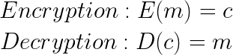
Homomorphic Encryption
Homomorphic encryption is a form of encryption that allows computations to be carried out on ciphertext, thus generating an encrypted result which, when decrypted, matches the result of operations performed on the plaintext.
f(x@y)=f(x)@f(y) where @ can be any operator.
Let’s define out notation for message, ciphertext, encryption, and decryption:
Assuming homomorphism, we then get:

Slide 12
Homomorphic Encryption
For a toy private addition: E(x)=k*x, where k can be any real number except 0 :
E(m₁) + E(m₂) = k*m₁ +k*m₂ =k*(m₁+m₂) =E(m₁+m₂)
For a more realistic RSA example: E(m)=m^{e} mod r, where mod r and exponent e are public key :

Slide 13
Homomorphic Encryption
a. Traditional Cloud Storage and Computation
b. HE based Cloud Storage and Computation
Workflow comparison of outsourced computation between traditional and HE-based cloud storage and computation.

Slide 14
Genome Imputation—iDASH2019
Illustration of taking genotype imputation as a classification problem. These missing SNPs are imputed by using their adjacent SNPs.
SNPs representation and imputation workflow.
http://www.humangenomeprivacy.org/2019/competition-tasks.html

Slide 15
Genome Imputation—iDASH2019
Cyphertext
Cyphertext

Slide 16
Genome Imputation—iDASH2019
Predict time around 10 min in cyphertext, 20s in plaintext in 4 CPU cores (Intel Xeon Platinum 8180 CPU @ 2.50GHz), 32 GB memory, and 500 GB storage in evaluation.

Slide 17
Secure Multiparty Computation
Yao’s millionaires’ Problem
Solution:
The trusted third person
Alice
Bob
This problem discusses two millionaires, Alice and Bob, who are interested in knowing which of them is richer without revealing their actual wealth.

Slide 18
Secure Multiparty Computation
Private auction
Many parties wish to execute a private auction
The highest bid wins
Only the highest bid (and bidder) is revealed
Solution
a trusted auctioneer

Slide 19
Secure Multiparty Computation

Slide 20
Secure Multiparty Computation
Parties 𝑃₁, …, 𝑃_{𝑛}
Party 𝑃_{𝑖} has private input 𝑥_{𝑖}
The parties wish to jointly compute a (known/unknown) function 𝑦 = 𝑓(𝑥₁, …, 𝑥_{𝑛})
The computation must preserve certain security properties, even is some of the parties collude and maliciously attack the protocol.

Slide 21
Example--Private Addition
Enc(x, r) * Enc (y, s)
= (g^{x} * r^{n} mod n²) * (g^{y} * s^{n} mod n²)
=g^{(x+y)} * (r*s)^{n} mod n²
=Enc(x+y, r*s)
x, y are two real numbers;
g, n combine a public key;
r is a private key; s is another private key.

Slide 22
FairplayMP – A System for Secure Multi-Party Computation
https://www.cs.huji.ac.il/project/Fairplay/
Ben-David, A., et al. (2008). FairplayMP: a system for secure multi-party computation. Proceedings of the 15th ACM conference on Computer and communications security, ACM.

Slide 23
SecureNN: Efficient and Private Neural Network Training
Wagh, S., et al. (2018). "SecureNN: Efficient and Private Neural Network Training." IACR Cryptology ePrint Archive 2018: 442.

Slide 24
Differential Privacy (DP)
Differential privacy is a system for publicly sharing information about a dataset by describing the patterns of groups within the dataset while withholding information about individuals in the dataset.
Database
Histogram
New individual’s phenotype

Slide 25


Differential Privacy
Data owner
Data miner
name | sex | age | disease | salary
Ada | F | 18 | cancer | 25k
Bob | M | 25 | heart | 110k
Cathy | F | 20 | cancer | 70k
Dell | M | 65 | flu | 65k
Ed | M | 60 | cancer | 300k
Fred | M | 24 | flu | 20k
George | M | 22 | cancer | 45k
Harry | M | 40 | flu | 95k
Irene | F | 45 | heart | 70k
Query f
infer that Ed has a cancer

Slide 26
Differential Privacy
Data owner
Data miner
name | sex | age | disease | salary
Ada | F | 18 | cancer | 25k
Bob | M | 25 | heart | 110k
Cathy | F | 20 | cancer | 70k
Dell | M | 65 | flu | 65k
Ed | M | 60 | cancer | 300k
Fred | M | 24 | flu | 20k
George | M | 22 | cancer | 45k
Harry | M | 40 | flu | 95k
Irene | F | 45 | heart | 70k
Query f
How to decide the noise?
+ noise
Cannot be used to derive whether any individual is included in the database

Slide 27
Differential Guarantee
name | disease
Ada | cancer
Bob | heart
Cathy | cancer
Dell | flu
Ed | cancer
Fred | flu
K
f count(#cancer)
a_{i} ~ Laplacian distribution
f(x) + noise
3 + a₁ (noise)
name | disease
Ada | cancer
Bob | heart
Cathy | cancer
Dell | flu
Ed | cancer
Fred | flu
f count(#cancer)
K
f(x’) + noise
2 + a₂ (noise)

Slide 28
Local privacy and global privacy

Slide 29
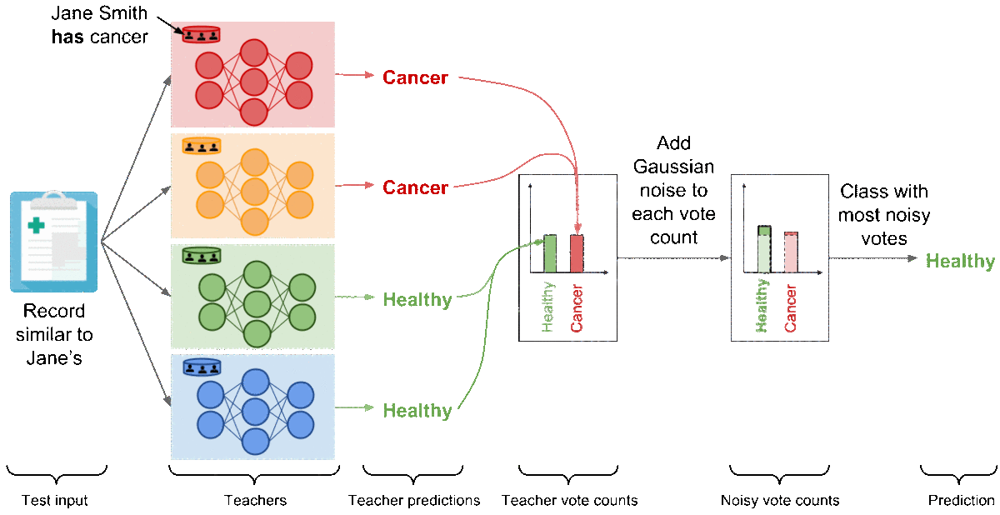
Differential Privacy in Machine Learning
DP
DP
DP

Slide 30
Hybrid Infrastructure for Privacy Preserving Distributed Machine Learning
DP
DP
DP

Slide 31
Questions?

